Slide 1

DESIGN AND IMPLEMENTATION OF HIGH SPEED ACQUISTION SCANNER AND 3D DISPLAY SYSTEM USING ULTRASONIC ECHO DATA
Submitted by: Kanchan Solanki, Krishna Kumar, Manish Verma and Mukul Thakur
Under the Supervision of
Mrs Priyanka Verma (Asst. Prof. ECE)

Slide 2
TABLE OF CONTENTS:
Introduction
Literature Survey
Problem Formulation
Objective
Block Diagram
Current Progress
Applications
References

Slide 3
INTRODUCTION:
In the modern world, there are numerous ways by which an object can be analysed at multiple levels where human eyes fail to perceive it.
But like every technology has its own limitations, these imaging technologies also fail in some aspects, be it their usability or effectiveness.
Ultrasound technology has been found to be more efficient in terms of its effectiveness and the safety hazards that are imposed by other imaging technologies on the environment.

Slide 4
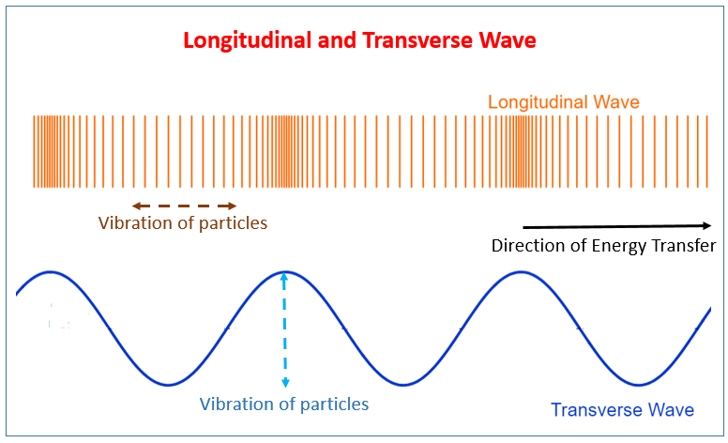
Unlike other imaging technologies which make use of some or other kind of ionizing radiation for efficient imaging e.g. X-Ray Imaging, Ultrasound technology is based on non-ionizing radiation, like pressure waves in a medium.

Slide 5
LITERATURE SURVEY:
S.No | TITLE | AUTHOR | PUBLICATION | YEAR | OUTCOME
[1] | Motion Artefacts and Correction in Multipulse High-Frame Rate Contrast-Enhanced Ultrasound | A. Stanziola, M. Toulemonde, Y. Li, V. Papadopoulou, R. Corbett, N. Duncan, R. J. Eckersley, M. X. Tang | IEEE | 2019 | High Frame rates Ultrasound Imaging is combined with Contrast Enhanced Ultrasound Imaging. For High Frame rates, Coherent Compounding technique is used in which Transverse waves are sent in the medium to increase it speed but this technique results in Degradation of the Image quality. So both the techniques are used together to get High frame rates with good quality Image.
[2] | Improved Plane-Wave Ultrasound Beamforming by Incorporating Angular Weighting and Coherent Compounding in Fourier Domain | Chuan Chen, Gijs A. G. M. Hendriks, Ruud J. G. van Sloun, Hendrik H. G. Hansen, Chris L. de Korte | IEEE | 2018 | In this paper, a processing framework aimed at improving the Ultrasound Data by using Fourier-domain beamforming of plane-wave. This technique incorporates both Coherent Compounding and Angular Weighting. Angular Weighting involves processing of spectral data using 2-D steering-angle Filtering template.

Slide 6
[3] | Design and characterization of dual-curvature 1.5-dimensional high-intensity focused ultrasound phased-array transducer | Gin-Shin Chen, Che-Yu Lin, Jong Seob Jeong, Jonathan M. Cannata, Win-Li Lin, Hsu Chang, K. Kirk Shung | IEEE | 2012 | A dual-curvature focused ultrasound phased-array transducer with a symmetric control has been developed for non-invasive ablative treatment of tumours. The 1.5-D array was constructed in-house and the electro-acoustic conversion efficiency was measured to be approximately 65%.
[4] | A Vector Flow Imaging Method for Portable Ultrasound Using Synthetic Aperture Sequential Beamforming | Tommaso Di Ianni, Carlos Armando Villagómez Hoyos, Caroline Ewertsen, Thomas Kim Kjeldsen, Jesper Mosegaard, Michael Bachmann Nielsen, Jorgen Arendt Jensen | IEEE | 2017 | This paper presents a vector flow imaging method for the integration of quantitative blood flow imaging in portable ultrasound systems. The method combines directional transverse oscillation (TO) and synthetic aperture sequential beamforming to yield continuous velocity estimation in the whole imaging region. Six focused emissions are used to create a high-resolution image (HRI), and a dual-stage beamforming approach is used to lower the data throughput between the probe and the processing unit.
[5] | Fully Automatic Three-dimensional Ultrasound Imaging Based on Conventional B-Scan | Qinghua Huang, Bowen Wu, Jiulong Lan, Xuelong Li | IEEE | 2018 | In this paper, we propose a fully automatic scanning system for three-dimensional (3-D) ultrasound imaging. A depth camera was first used to obtain the depth data and colour data of the tissue surface. Based on the depth image, the 3-D contour of the tissue was rendered and the scan path of ultrasound probe was automatically planned. Following the scan path, a 3-D translating device drove the probe to move on the tissue surface.

Slide 7
[6] | Sub-Nyquist Sampling and Fourier Domain Beamforming in Volumetric Ultrasound Imaging | Not Mentioned | IEEE | 2016 | High-resolution digital beamforming introduces the demand for sampling rates significantly higher than the signals' Nyquist rate, which greatly increases the volume of data that must be transmitted from the system's front end. In 3-D ultrasound imaging, 2-D transducer arrays rather than 1-D arrays are used, and more scan lines are needed. This implies that the amount of sampled data is vastly increased with respect to 2-D imaging.
[7] | 3-D imaging using row-column addressed 2-D arrays with a diverging lens: Phantom study | Hamed Bouzari, Mathias Engholm, Christopher Beers, Matthias Bo Stuart, Erik Vilain Thomsen, Jorgen Arendt Jensen | IEEE | 2017 | A double-curved diverging lens over the flat row-column-addressed 2-D array can extend its inherent rectilinear 3-D imaging field of view (FOV) to a curvilinear volume region, which is necessary for applications such as abdominal and cardiac imaging. Two concave lenses with radii of 12.7 and 25.4 mm were manufactured using RTV664 silicone. The diverging properties of the lenses were evaluated based on simulations and measurements on several phantoms.
[8] | Width-modulated square wave pulses for ultrasound applications | Peter R. Smith, David M. J. Cowell, Steven Freear | IEEE | 2013 | A method of output pressure control for ultrasound transducers using switched excitation is described. The method generates width-modulated square-wave pulse sequences that are suitable for driving ultrasound transducers using MOSFETs or similar devices. Sequences are encoded using an optimized level-shifted, carrier-comparison, pulse-width modulation (PWM) strategy derived from existing PWM theory, and modified specifically for ultrasound applications.

Slide 8
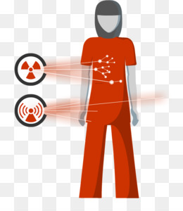
PROBLEM FORMULATION:
Environmental Hazard
One of the major issues countered by ultrasound technology is that it doesn’t employs any use of ionizing radiation. Since these pressure waves occur in nature in the form of variations in pressure, these variations don’t cause any kind of ionization.
Maintenance and cost
Ultrasound technology employs piezoelectric crystals as the main driving elements which are way less expensive than the materials used to manufacture other sources like X-Ray tubes and heavy magnets used in MRI scanners or the photomultiplier tubes.

Slide 9
OBJECTIVE:
Transmission of ultrasonic pulses
Reflection of ultrasound waves
Reception of reflected waves

Slide 10
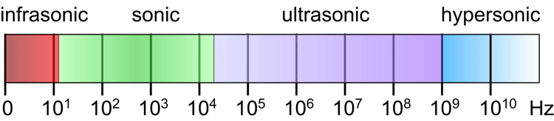
TRANSMISSION OF ULTRASONIC PULSES:
This is the first process in which ultrasound waves are generated to insonify the object under analysis. Insonification is analogous to the Illumination effect which happens when a certain amount of light falls on an object. The principle behind this phase is the reverse piezoelectric effect.
The piezoelectric effect is observed when a voltage is induced in a crystal when certain mechanical stress is applied to it. The reverse effect also exists in which vibrations are produced by the crystal on the application of electrical signals.

Slide 11
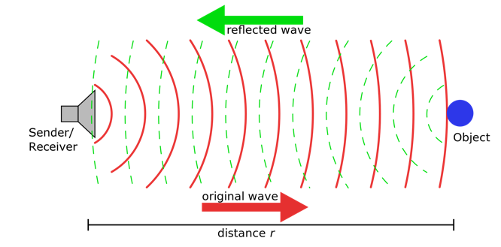
REFLECTION OF ULTRASOUND WAVES:
This phase is the basis of addition of details into the plain waves transmitted in the previous process. When the waves fall on an object, a portion of the total energy gets reflected back and the rest part of energy penetrates into the object.
These sudden changes can be of any magnitude depending on the density of the media involved e.g. solid-liquid, liquid-gas, solid-gas, liquid-liquid, solid-solid, etc.

Slide 12
RECEPTION OF REFLECTED WAVES:
This is the last phase in the whole process which involves sensing of the reflected waves.
When the reflected waves fall back on the transducer, a small electrical signal is generated by the crystal when it absorbs the ultrasonic vibrations.
These electrical signals are further processed and converted into digital signals with the help of Analog to Digital Converters and other devices.
The digital signals generated in this phase go through some or other kind of image processing using software.

Slide 13
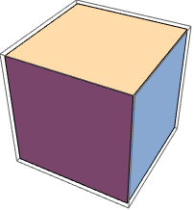

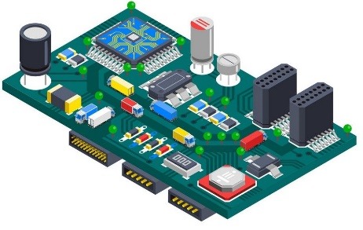
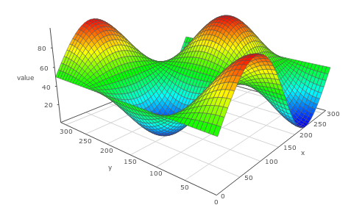

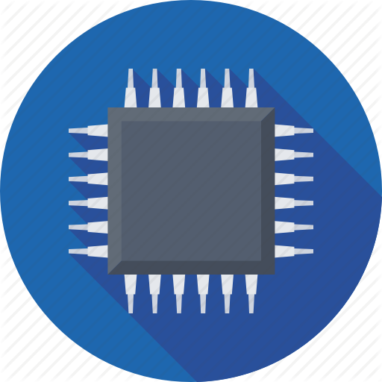
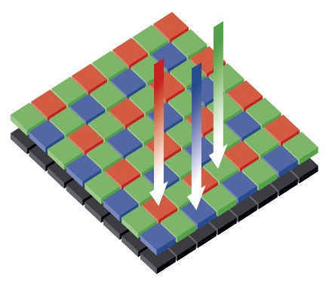
BLOCK DIAGRAM:
Object
Display
Ultrasonic
Frequency
Generator
Image
Reconstruction
Data
Acquisition
Transducer
Array

Slide 14
CURRENT PROGRESS:
Transceiver composed of multiple ultrasonic sensors in the form of two-dimensional array formation has been completed.
Connector PCB’s for re-routing sensor signals fabrication completed.
Main motherboard consisting of processing unit along with multiplexing and demultiplexing units has been logically designed.
Image reconstruction code/software with 3D image output has been developed using MATLAB platform.
Schematic and PCB Board designs for the main PCB has been done but not fabricated due to this current pandemic.

Slide 15
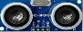
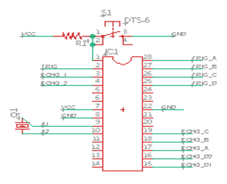
Flow Diagram of sensors array signals:
1:8 DEMUX
TRIGGER
ECHO
8:1 MUX
1:8 DEMUX
8:1 MUX
1:8 DEMUX
8:1 MUX
1:8 DEMUX
8:1 MUX
Ultrasonic sensor array
1:8 DEMUX
8:1 MUX
1:8 DEMUX
8:1 MUX
S0
S1
S2
S0
S1
S2
1:8 DEMUX
8:1 MUX

Slide 16
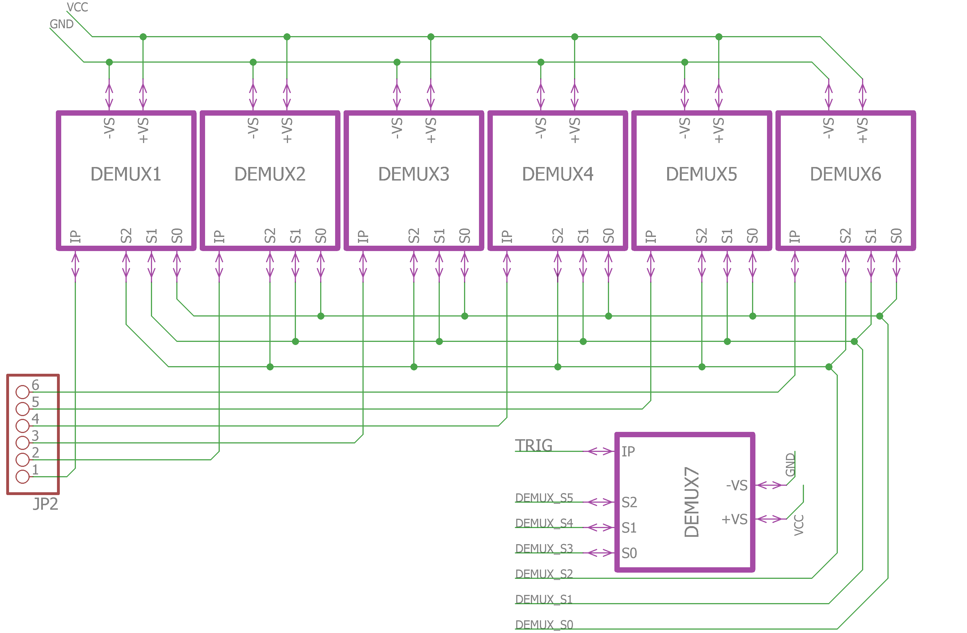
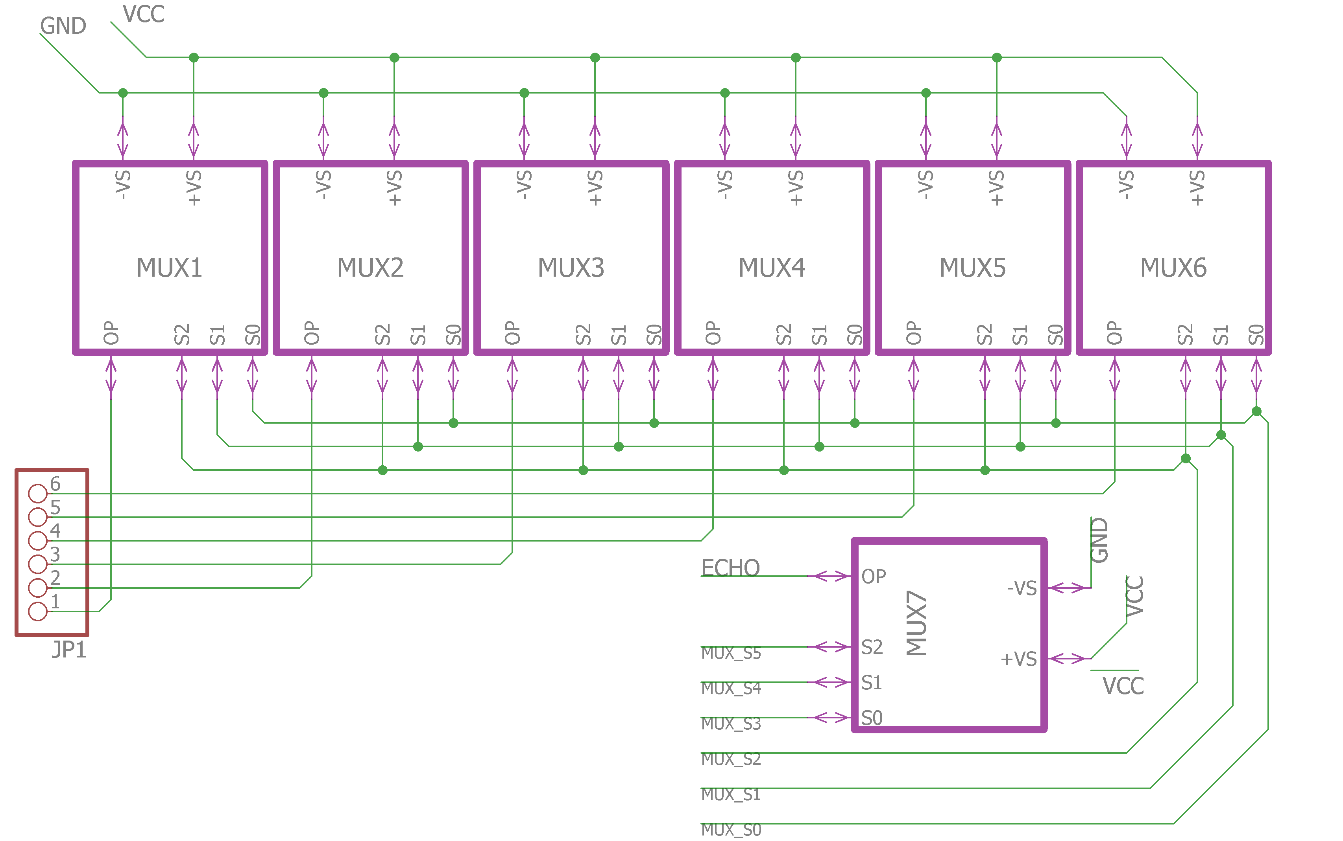
Schematic Designs:
Demultiplexing block for trigger signals
Multiplexing block for echo signals

Slide 17
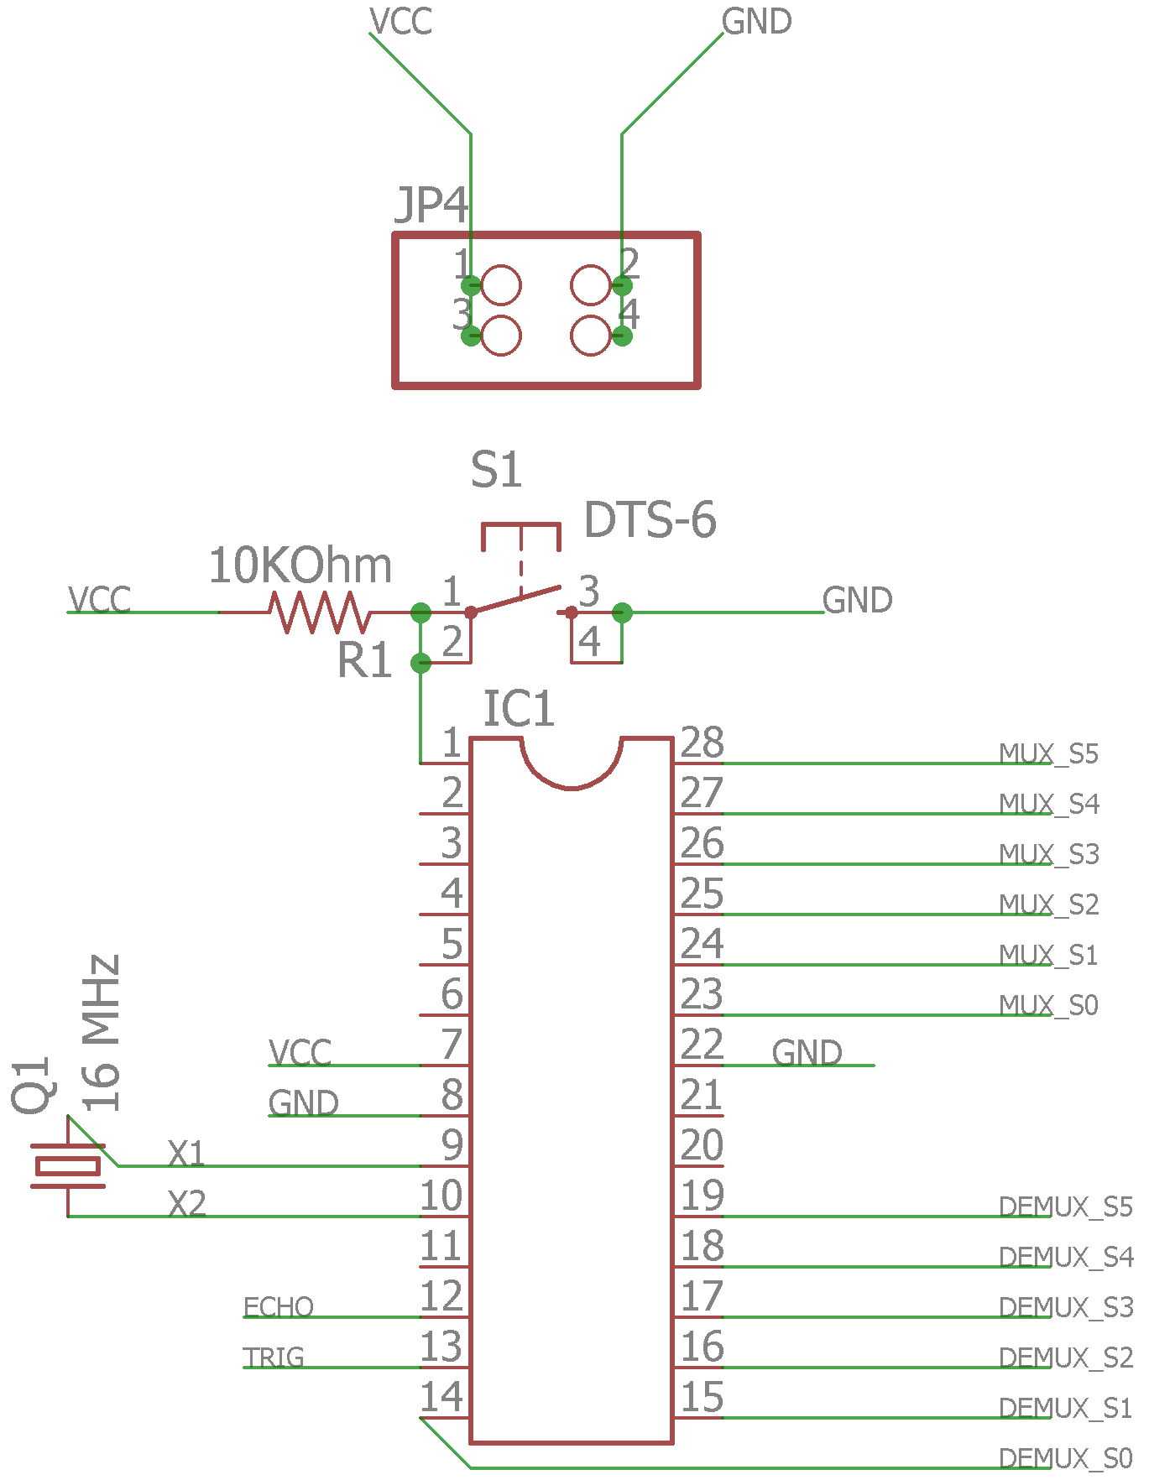
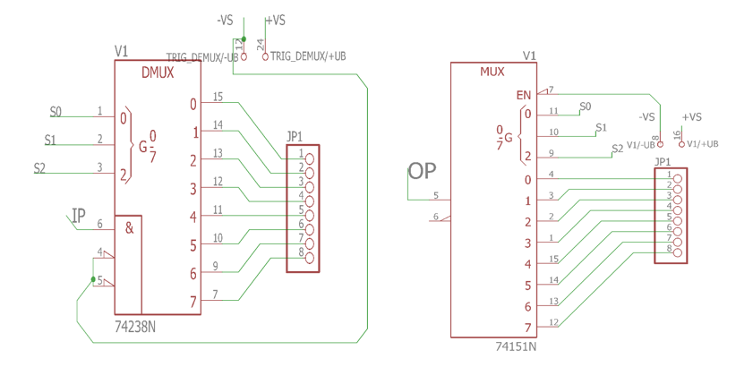
Schematic Designs:
Multiplexer and Demultiplexer module internal schematics used in above schematics
Main CPU Environment

Slide 18
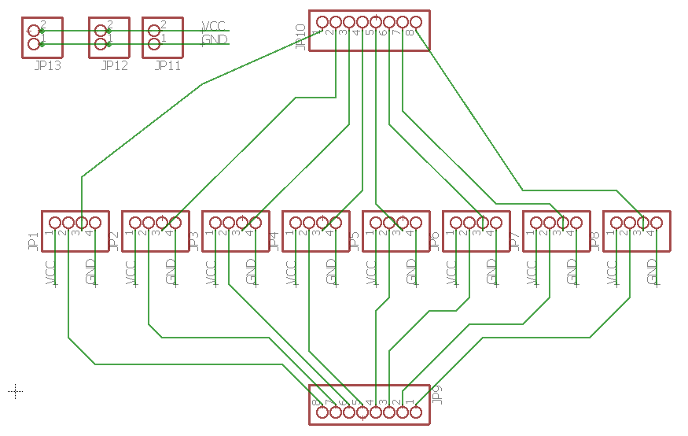
Schematic design for re-routing Ultrasonic sensor signals to be connected with MUX and DEMUX units

Slide 19
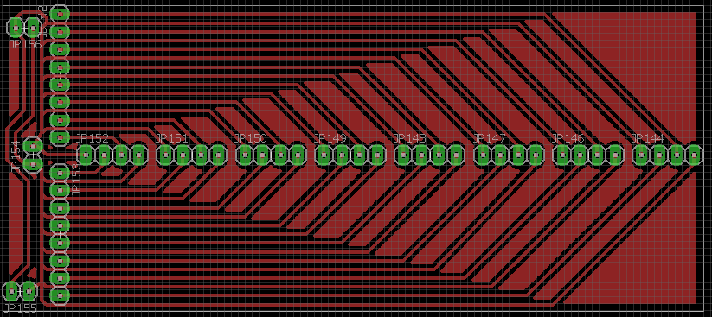
PCB layout for re-routing Ultrasonic sensor signals to be connected with MUX and DEMUX units

Slide 20
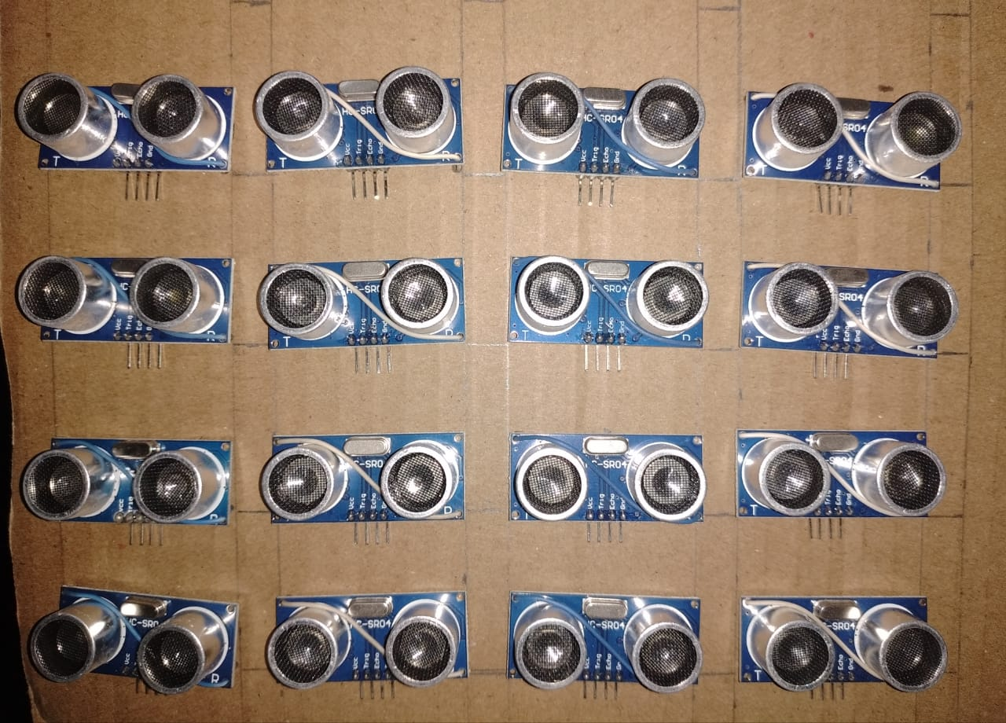
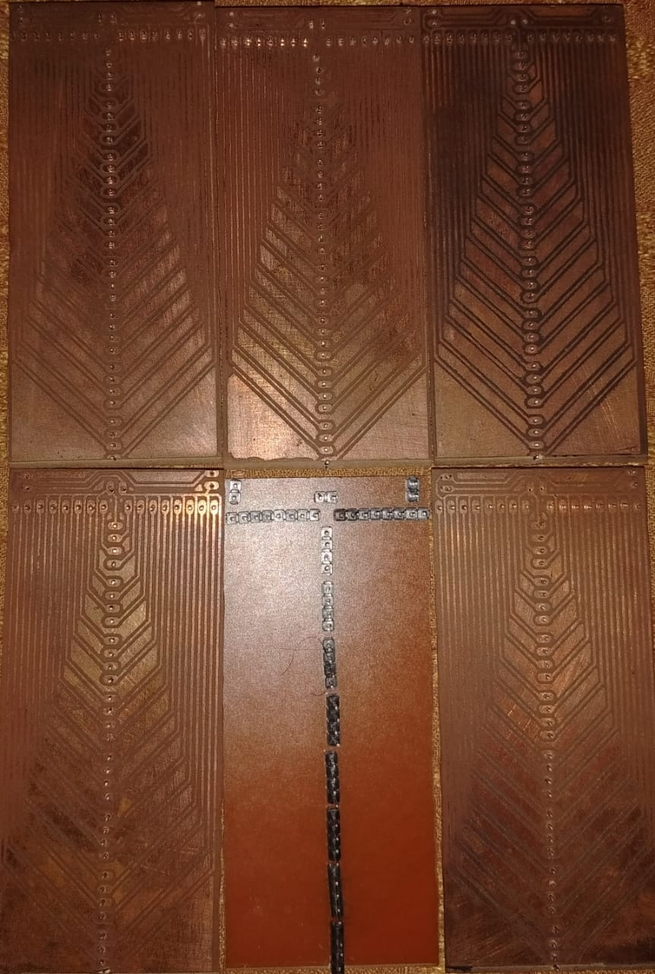
Developed hardware
Ultrasonic Sensor Array
Sensor signal re-routing PCB

Slide 21
Image Reconstruction Code :
clc;
close all;
clear all;
%Take input data and display it
d=input('Enter values of matrix: \n');
disp(d);
s=size(d);
fprintf('\n Dimesions of your data: %drows %dcolumns\n \n',s(1),s(2));
%Blank points
res=30;
disp(res);
%Creating a blank canvas array for image storage
disp(s(1)+res*(s(1)-1));
disp(s(2)+res*(s(2)-1));
z=zeros(s(1)+res*(s(1)-1) ,s(2)+res*(s(2)-1));
disp(z);
%Saving raw acquired data into blank canvas array
m = 1;
n = 1;
for ( i = 1 : s(1) )
for ( j = 1 : s(2) )
z(m,n) = d(i,j);
n = n + res + 1;
end
n=1;
m = m + res + 1;
end
%Display message
fprintf('\n Saving of raw data in blank canvas array is done \n');

Slide 22
Continue….
disp(z);
%Reconstruction code working row-wise
for ( i = 1 : s(1))
m=1;
roff = (i-1)*res + i;
for ( j = 1 : (s(2) - 1) )
ip = z(roff,m);
m = m + res + 1;
fp = z(roff,m);
slo=(fp - ip)/(res + 1);
coff=(j-1)*res+j;
for ( k = 1 : res )
val= slo*k + ip;
z(roff ,k+coff)=val;
end
end
end
disp(z);
%Reconstruction code working column-wise
zsize=size(z);
for ( i = 1 : zsize(2) )
m=1;
for ( j = 1 : (s(1) - 1) )
ip = z(m,i);
m = m + res + 1;
fp = z(m,i);
slo=(fp - ip)/(res + 1);
roff=(j-1)*res+j;
for ( k = 1 : res )
val= slo*k + ip;
z(k + roff ,i)=val;
end

Slide 23
Continue….
end
end
disp(z);
surfl(z)
colormap(pink) % change color map
shading interp % interpolate colors across output object surface
% Code for serial user = input('Enter 7 to connect to Data acquisition system:'); if (user == 7) atmega=serial('COM13'); disp(atmega); fopen(atmega); disp(atmega);
write(atmega,48,'uint8'); pause(0.5); fprintf(atmega,'Hello'); pause(0.5); tline = fgets(atmega); disp(tline); for(k=1:s(2))
d(k)=fread(atmega,s(1));
end
%disp(d); fclose(atmega); disp(atmega); end

Slide 24
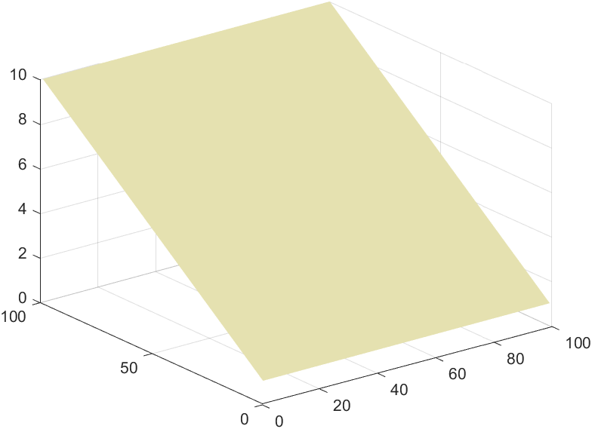
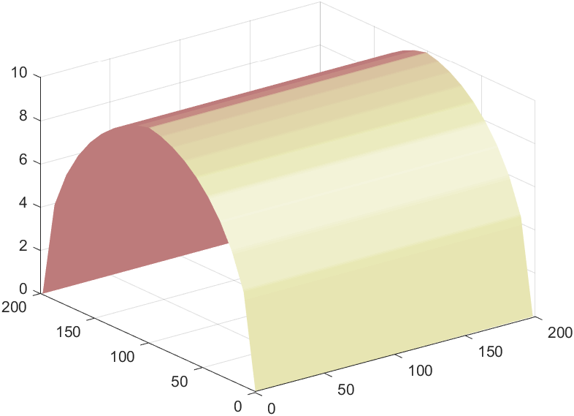
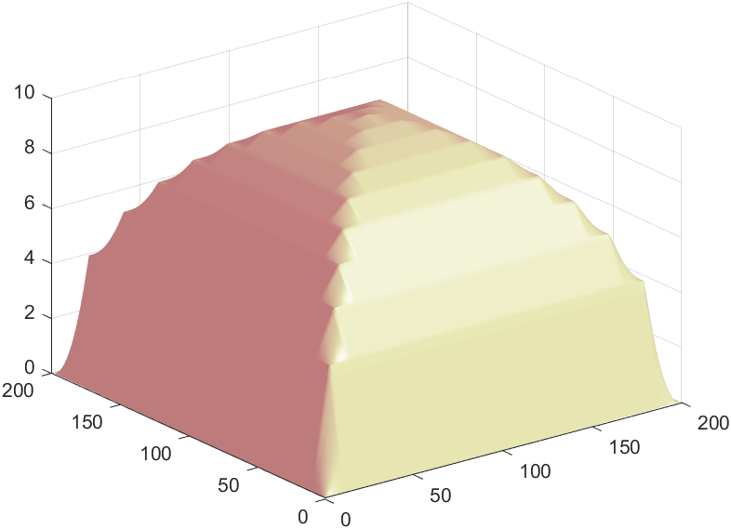
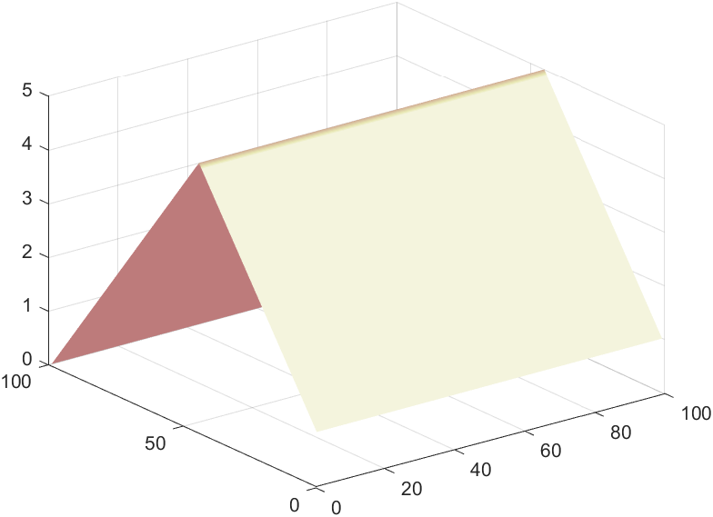
Example Output results from Code:
Cylindrical object
Spherical Object

Slide 25
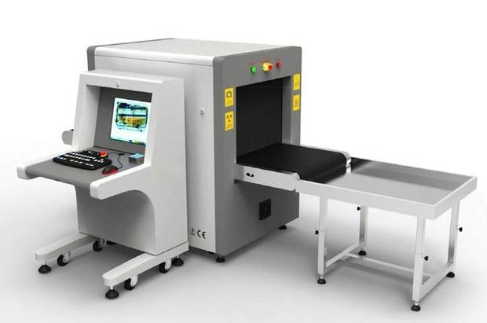
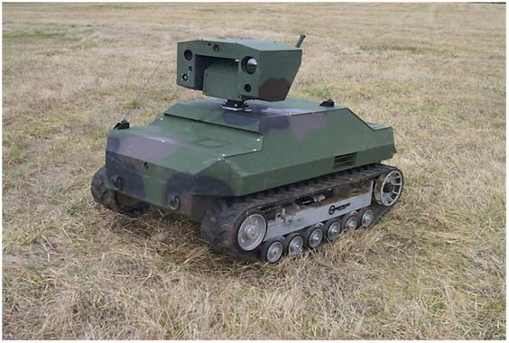
APPLICATIONS:
Security
The future prospects of this technology involve places where security plays a very crucial role like Airports, Railway stations and important places where a need to check objects thoroughly is a must.
Robotics in defence
The need for visualization of objects without making any actual contact with objects is increasing. Especially in defence applications where unattended objects can prove to be dangerous, there should exist a system for visualising these kinds of objects.

Slide 26
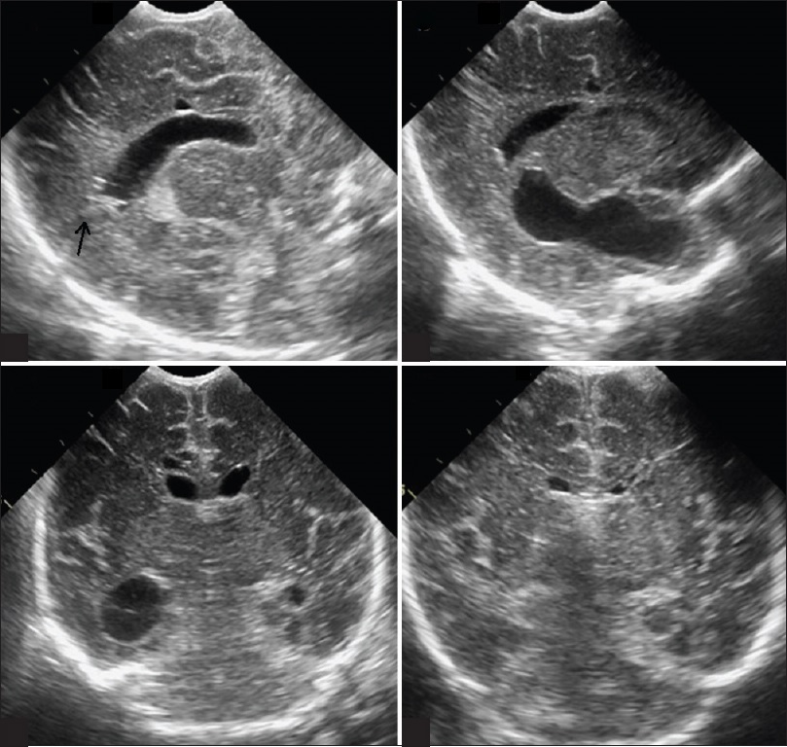
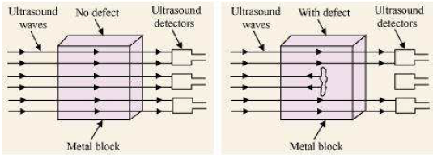
APPLICATIONS:
Medical
At present, Ultrasound technology is widely used in medical field and has been developed to a great extent where the results are well detailed and a scan can be done at much less cost.
Quality Control
Ultrasound Technology can find a good use in the quality check of products after they have been manufactured in factories.

Slide 27
REFRENCES:
[1] A. Stanziola, M. Toulemonde, Y. Li, V. Papadopoulou, R. Corbett, N. Duncan, R. J. Eckersley, M. X. Tang, “Motion Artefacts and Correction in Multipulse High-Frame Rate Contrast-Enhanced Ultrasound”, IEEE Trans. on Ultrasonics, Ferroelectrics, and Frequency Control, 2019.
[2] Chuan Chen, Gijs A. G. M. Hendriks, Ruud J. G. van Sloun, Hendrik H. G. Hansen, Chris L. de Korte, “Improved Plane-Wave Ultrasound Beamforming by Incorporating Angular Weighting and Coherent Compounding in Fourier Domain”, IEEE Trans. on Ultrasonics, Ferroelectrics, and Frequency Control, 2018.
[3] Gin-Shin Chen, Che-Yu Lin, Jong Seob Jeong, Jonathan M. Cannata, Win-Li Lin, Hsu Chang, K. Kirk Shung, “Design and characterization of dual-curvature 1.5-dimensional high-intensity focused ultrasound phased-array transducer”, IEEE Trans. on Ultrasonics, Ferroelectrics, and Frequency Control, 2012.
[4] Tommaso Di Ianni, Carlos Armando Villagómez Hoyos, Caroline Ewertsen, Thomas Kim Kjeldsen, Jesper Mosegaard, Michael Bachmann Nielsen, Jorgen Arendt Jensen, “A Vector Flow Imaging Method for Portable Ultrasound Using Synthetic Aperture Sequential Beamforming”, IEEE Trans. on Ultrasonics, Ferroelectrics, and Frequency Control, 2017.
[5] Qinghua Huang, Bowen Wu, Jiulong Lan, Xuelong Li, “Fully Automatic Three Dimensional Ultrasound Imaging Based on Conventional B-Scan”, IEEE Trans. on Biomedical Circuits and Systems, 2018.
[6] “Sub-Nyquist Sampling and Fourier Domain Beamforming in Volumetric Ultrasound Imaging”, IEEE Trans. on Ultrasonics, Ferroelectrics, and Frequency Control, 2016.
[7] Hamed Bouzari, Mathias Engholm, Christopher Beers, Matthias Bo Stuart, Erik Vilain Thomsen, Jorgen Arendt Jensen, “3-D imaging using row-column addressed 2-D arrays with a diverging lens: Phantom study”, 2017. [8] Peter R. Smith, David M. J. Cowell, Steven Freear, “Width-modulated square wave pulses for ultrasound applications”, IEEE Trans. on Ultrasonics, Ferroelectrics, and Frequency Control, 2013.

Slide 28

QUESTIONS?

Slide 29


